Slide 1









Implementation Task 01 - Decision Trees
Breast Cancer Malignancy Prediction
Leveraging Machine Learning for Early Diagnostic Support
Project by:Waqar Khan, Muhammad Zarar
Reg no:SP24-BAI-055, SP24-BAI-039

Slide 2













Breast Cancer Malignancy Prediction
Implementation Task 01 - Decision Trees
The Diagnostic Imperative
Global Health Challenge
Breast cancer stands as aleading cause of mortalityamong women worldwide.
Project Objective
Critical Goal
Develop arobust, data-driven toolto assist medical professionals
Early and accurate diagnosisis the single most important factor for improving patient survival rates.
Enablebinary classificationof tumor masses (Benign/Malignant)
Enhancediagnostic supportand decision-making process
The Challenge
Improvepatient outcomesthrough earlier and more accurate detection
Classifying tumor masses asBenign vs. Malignantbased on cellular analysis is ahigh-stakes, time-sensitivetask demanding precision and reliability.
"The imperative for early and accurate diagnosis cannot be overstated."
Implementation Task 01 - Decision Trees

Slide 3







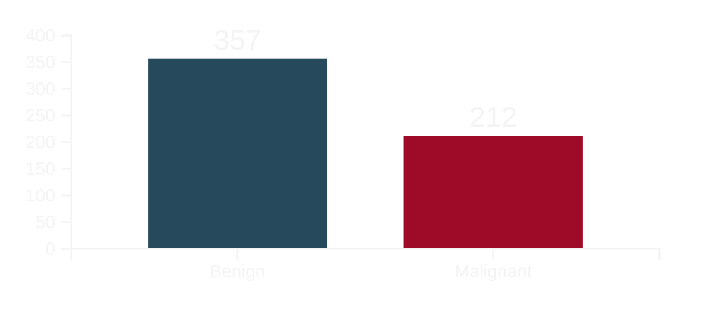











Breast Cancer Malignancy Prediction
Implementation Task 01 - Decision Trees
The Dataset
Wisconsin Diagnostic Breast Cancer (WDBC) Dataset
569instances (patients) with33features
Data Acquisition
Class Distribution
Features are computed from digitized images of a Fine Needle Aspirate (FNA) of breast masses.
Input Features
30 measurements, each with 3 values (mean, standard error, worst):
radius
texture
perimeter
area
compactness
concavity
Slight class imbalance (357 Benign vs. 212 Malignant)
concave points
symmetry
fractal dimension
Feature Structure
Target Variable
Diagnosis:Malignant orBenign
Implementation Task 01 - Decision Trees

Slide 4














Breast Cancer Malignancy Prediction
Implementation Task 01 - Decision Trees
Preparing Data for the Model
2. Categorical Encoding
1. Data Cleaning
3. Feature Scaling
Converted diagnosis from ('M', 'B') to numerical
Removed non-predictive columns (id)
AppliedStandardScalerto all 30 features
Eliminated all-null column (Unnamed: 32)
Mapping:Malignant (M)=1,Benign (B)=0
Transformed data to have μ=0 and σ=1
Why Standardization Matters
Ensures all 30 features (e.g., large area vs. small smoothness) contributeequallyto the model training process, preventing features with larger numerical ranges from disproportionately influencing the model.
Implementation Task 01 - Decision Trees

Slide 5









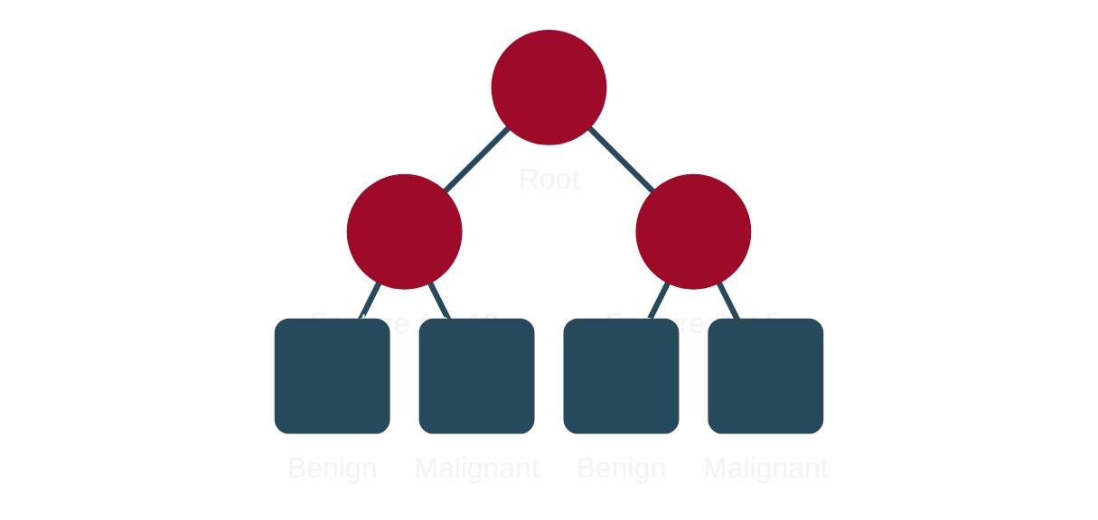






Breast Cancer Malignancy Prediction
Implementation Task 01 - Decision Trees
Why a Decision Tree?
Model Chosen:Decision Tree Classifier
Interpretability
Non-Parametric
Feature Importance
The "White Box" provides clear, rule-based decision paths crucial for clinical trust.
Makes no assumptions about data distribution, increasing robustness on real-world biological data.
Automatically identifies and prioritizes the most discriminative cell features.
Example:
Benefit:
Application:
"If radius_mean > 15.0 and concave_points_worst < 0.1, predict Malignant."
Handles complex, non-linear relationships between cellular features without distortion.
Focuses future research on the most impactful cellular measurements.
Clinical Impact
Decision Trees create afoundation of trustbetween model and medical professionals by providing clear decision logic.
The model's transparency enablesbalanced clinical judgmentbetween automated predictions and professional expertise.
Implementation Task 01 - Decision Trees

Slide 6















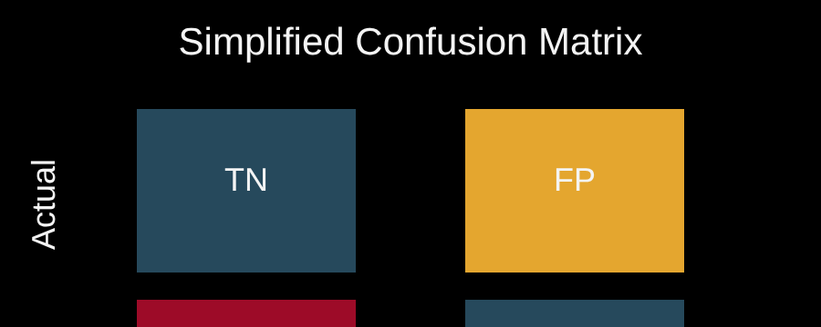
Breast Cancer Malignancy Prediction
Implementation Task 01 - Decision Trees
Model Evaluation
Performance Metrics
Error Analysis
Metric
Result
Interpretation
Critical Area: False Negatives
Test Accuracy
96.4%
Overall high predictive power
The model incorrectly classified3 malignant tumorsas benign.
Cross-Validation Score
92.97%
Robust performance (5-Fold CV)
This is acritical area for future workas it represents potentially missed diagnoses.
False Negatives
3 Cases
Malignant tumors classified as benign
False Positives
False Positives
1 Case
Benign tumor classified as malignant
The model incorrectly classified1 benign tumoras malignant.
This results in a false alarm that requires further examination.
Key Insight
Confusion Matrix
Our model demonstrates a96.4% accuracyrate, but the3 false negativesrepresent a critical trade-off that needs to be addressed in future model refinement.
Visual Analysis:
Feature Importance Bar Plot
Confusion Matrix
Implementation Task 01 - Decision Trees

Slide 7






















Breast Cancer Malignancy Prediction
Implementation Task 01 - Decision Trees
Decision Tree vs. Other Algorithms
Algorithm
Trade-offs
Why DT Preferred
Why Decision Tree Was Preferred
Balance of accuracy with interpretability
Our top choice
Decision Tree
Clinical Transparency
Superior transparency and simple decision path for initial deployment
Higher accuracy / Lower interpretability
Less transparent, harder to explain
Random Forest
Rule-Based Insight
Provides clear, logical reasoning for diagnoses
Linear / Less intuitive
Simple coefficients less informative
Logistic Regression
Efficiency
Faster prediction once trained
K-Nearest Neighbors
Instance-based / Slow prediction
Training is fast, prediction is slow
Decision Tree
Random Forest
Logistic Regression
K-Nearest Neighbors
Very high accuracy
High interpretability
Lower interpretability
Simple model
Simple to understand
Clear decision path
More complex
Less intuitive
Instance-based
Feature importance
Linear boundaries
Slow prediction
"Decision Tree provides a compelling balance of accuracy and interpretability for early diagnostic support."
Implementation Task 01 - Decision Trees

Slide 8










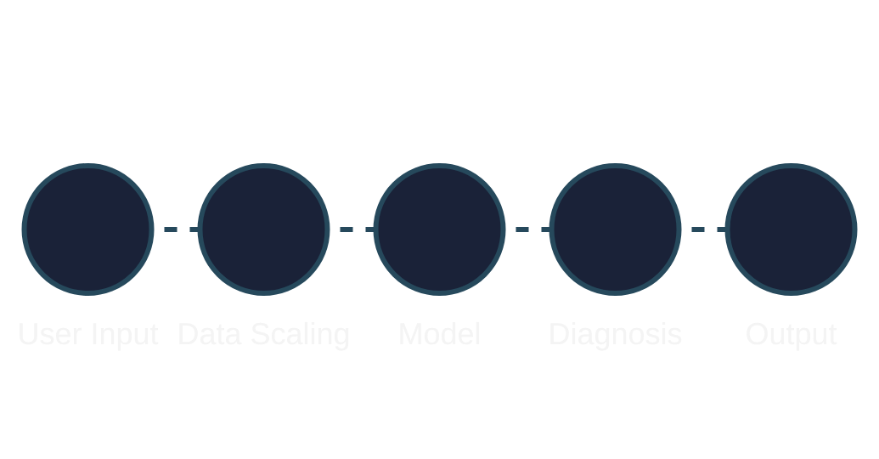




Breast Cancer Malignancy Prediction
Implementation Task 01 - Decision Trees
From Notebook to User Interface
Deployment Interface
Conclusion
Future Work
Streamlit was used to create an interactive web application:
The Decision Tree Classifier provides a compelling blend of:
Directions for model improvement:
Hyperparameter Tuning
Optimize model parameters to improve performance metrics
96.4%
Test Accuracy
Overall high predictive power
Ensemble Methods
Explore combining multiple algorithms for better results
92.97%
Cross-Validation Score
Robust and generalized performance
Reduce False Negatives
Accepts 30 user inputs (cell measurements)
Focus on minimizing critical false negative classifications
Scales input data correctly
Provides real-time diagnosis (Benign/Malignant)
The model provides a strong foundation for an early diagnostic support tool with its crucial interpretability.
Goal: Enhance patient safety and diagnostic reliability
Thank You
Implementation Task 01 - Decision Trees

